Slide 1
PARCO (Pak Arab Refinery Limited)
The Transshipment Problem
Zainab Aamir - 21100113
Mehwish Nadeem - 22110130
Ali Usama – 22110357
Zain Ul Abidin – 211000777

Slide 2
The Problem Introduction
PARCO is one of the largest companies in Pakistan’s corporate sector.
Three major services to offer: refining, transportation & marketing
We have focused on the transportation service.
In this problem, we find an optimal route with minimized costs for the transportation of the fuel.

Slide 3
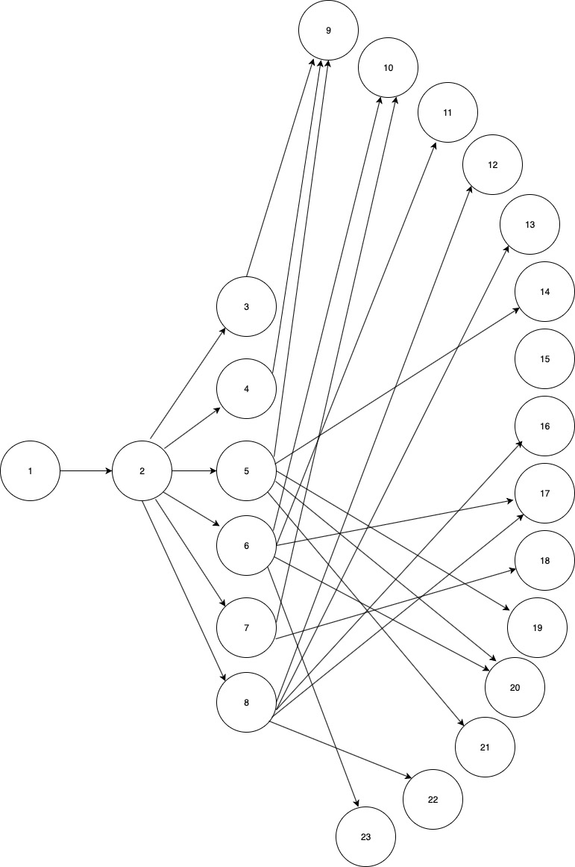
View of the network

Slide 4
Mathematical Formulation
The objective function is to minimize the total distance to minimize the costs associated. Hence, the objective function is:
MIN: ­ 748x12 + 889x23 + 357x24 + 0.7x25 + 252x26 + 412x27 + 695x28 + 5.5x39 + 1253.5x310 + 1156.1x311 + 1437.7x312 + 1595.6x313 + 903.8x314 + 171.8x315 + 1456.2x316 + 1220x317 + 1244.1x318 + 658.7x319 + 1091x320 + 848x321 + 1354.2x322 + 1074.4x323 + 512.5x49 + 792.6x410 + 695.3x411 + 973x412 + 885x413 + 425x414 + 360.4x415 + 991.5x416 + 759.2x417 + 783.2x418 + 204.1x419 + 572.6x420 + 339x421 + 893.3x422 + 613.6x423 + 893.8x59 + 394.6x510 + 297.3x511 + 575x512 + 732.9x513 + 58.9x514 + 741.7x515 + 593.5x516 + 361.2x517 + 385.2x518 + 259.3x519 + 206.5x520 + 49.4x521 + 495.4x522 + 238.3x523 + 1075x69 + 170x610 + 101x611 + 400x612 + 588x613 + 181x614 + 923x615 + 414x616 + 185x617 + 199x618 + 428x619 + 117x620 + 276x621 + 309x622 + 5x623 + 1245x79 + 65.7x710 + 139.3x711 + 311.7x712 + 471.7x713 + 338.5x714 + 1090x715 + 328.4x716 + 141.5x717 + 8.4x718 + 605.9x719 + 205.4x720 + 431.3x721 + 130.7x722 + 2016.1x723 + 1580.8x89 + 512.6x810 + 457.9x811 + 184.6x812 + 19.9x813 + 676x814 + 1441x815 + 180x816 + 378x817 + 463x818 + 946x819 + 525x820 + 523x821 + 352x822 + 555x823;
Where X_{IJ} denotes the amount of fuel, in metric tons, supplied from node I to node J
Constraints include:
Supply
Intermediate
Demand

Slide 5
The Model
Our model is a transshipment problem with a total of 23 nodes:
Total supply nodes = 1
Total intermediate nodes = 7
Total demand node s= 15
Supply nodes: 1
Intermediate nodes: 2, 3 ,4, 5, 6, 7, 8
Demand nodes: 9, 10, 11, 12, 13, 14, 15, 16, 17, 18, 19, 20, 21, 22, 23
Decision variables are the quantity of fuel being transported for every possible route.
Constraints are the supply, demand and storage capacity of each node

Slide 6
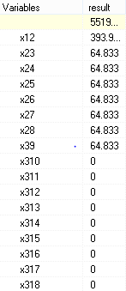
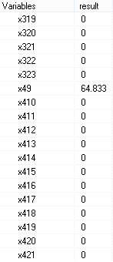
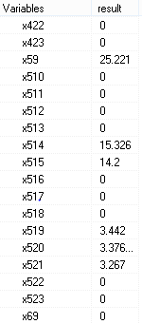
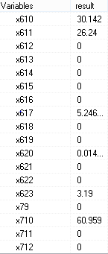
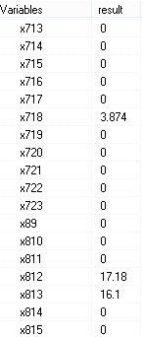
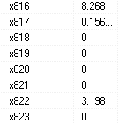
Results
We ran our model in the LP solver to get an optimal solution and the following results were obtained:
The above table represents that how much fuel is moving from one node to another while fulfilling the demand requirements of each final node with minimum cost.

Slide 7
Glossary
The node represents following areas/ storages:
1: Source
2: MCR
3: Kaemari storage plant
4: Shikarpur storage plant
5: Mehmoodkot storage plant
6: Sahiwal storage plant
7: Machike storage plant
8: Taru Jaba storage plant
9: Karachi
10: Lahore
11: Faisalabad
12: Rawalpindi
13: Peshawar
14: Multan
15: Hyderabad
16: Islamabad
17: Sargodha
18: Sheikhupura
19: Rahim Yar Khan
20: Jhang
21: Dera Ghazi Khan
22: Gujrat
23: Sahiwal

